Slide 1
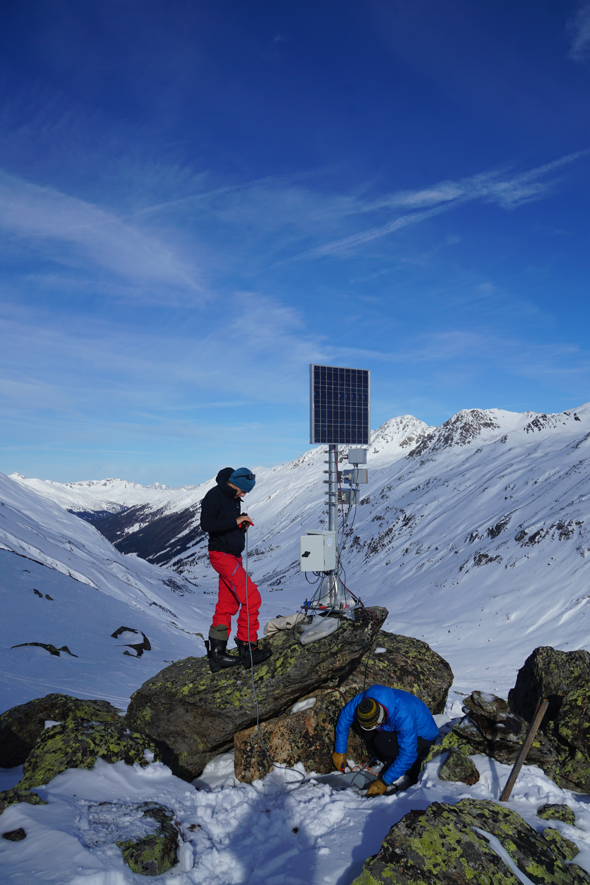
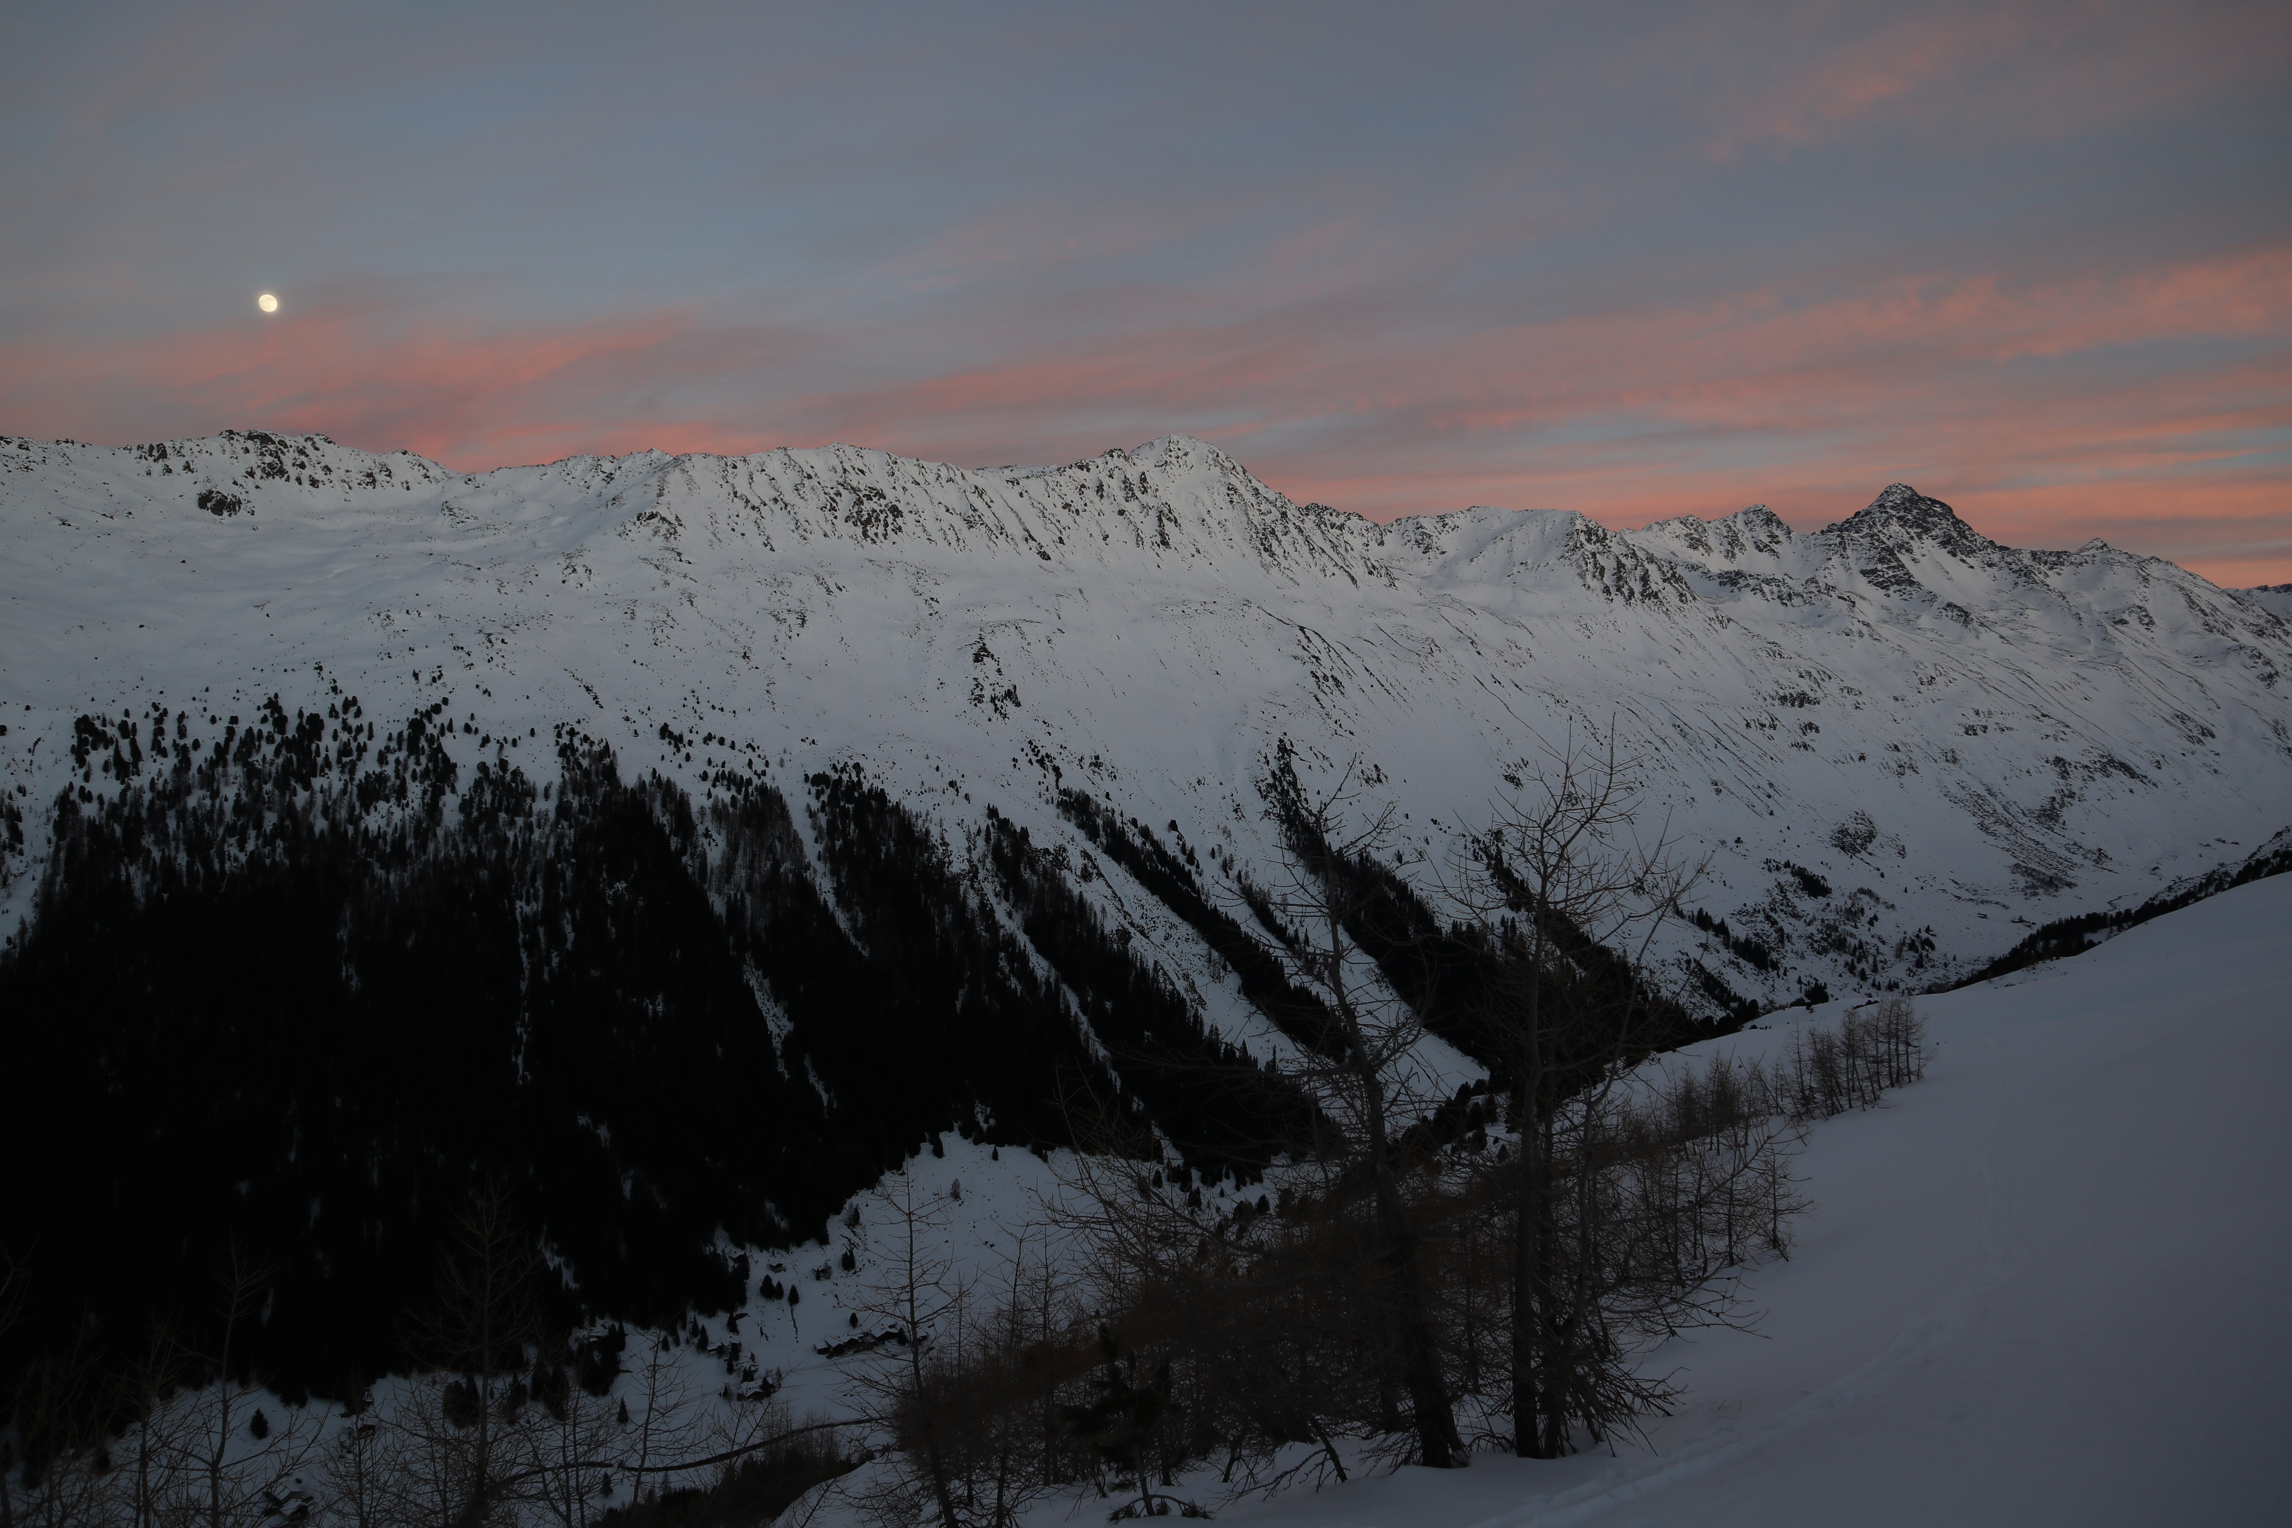
“Master thesis” Automatically identifying snow and sorting out foggy photographs relying on deep learning
SLF und Ecovision Lab@ETHZ/UZH Elisabeth Hafner, Yves Bühler Rodrigo Caye Daudt, Jan Dirk Wegner

Slide 2
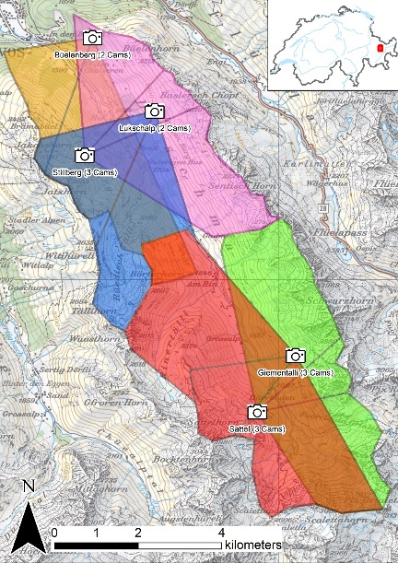
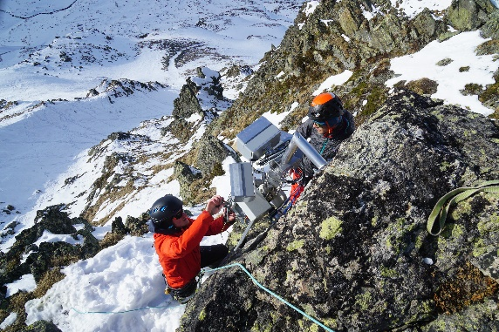
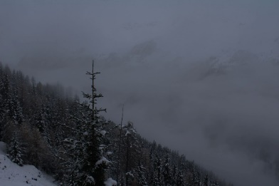
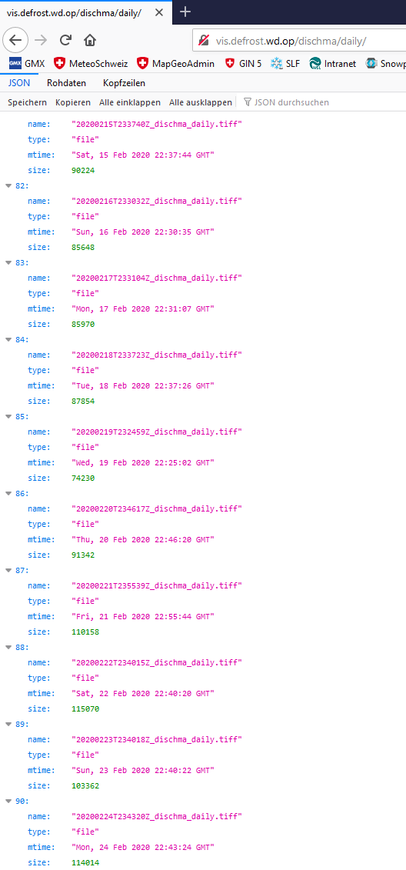
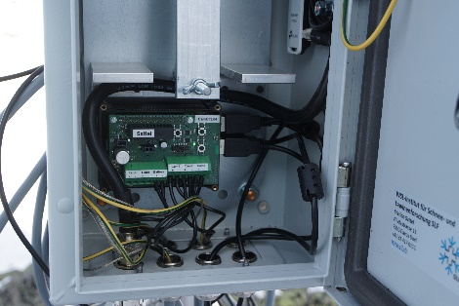
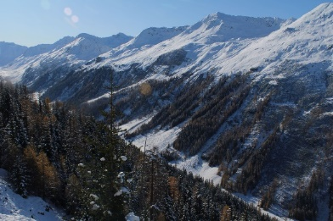
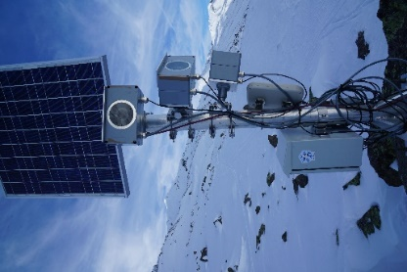
Past Project- DeFrost
test sites with infrastructure
selection of appropriate images
cameras acquiring images daily
snow classification, snow cover map generation
daily snowmaps for Dischma valley
improve snow classification
make independent of threshold
Notes:
Connected to Coordinates from master Image
System still used today!! Important for future

Slide 3
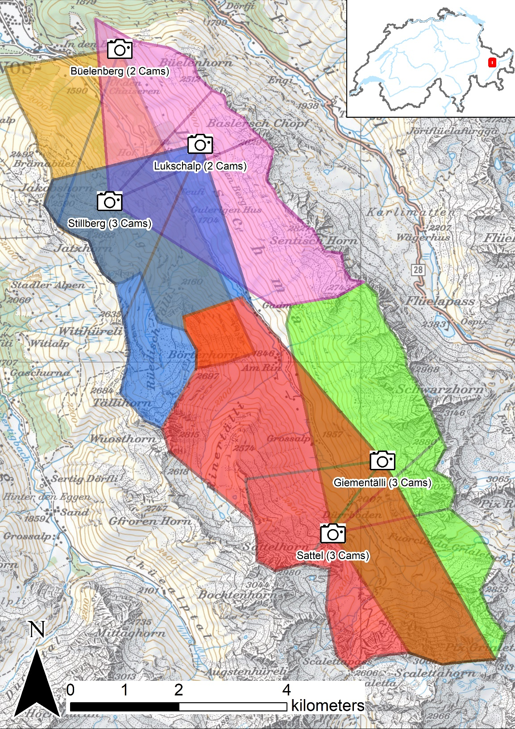
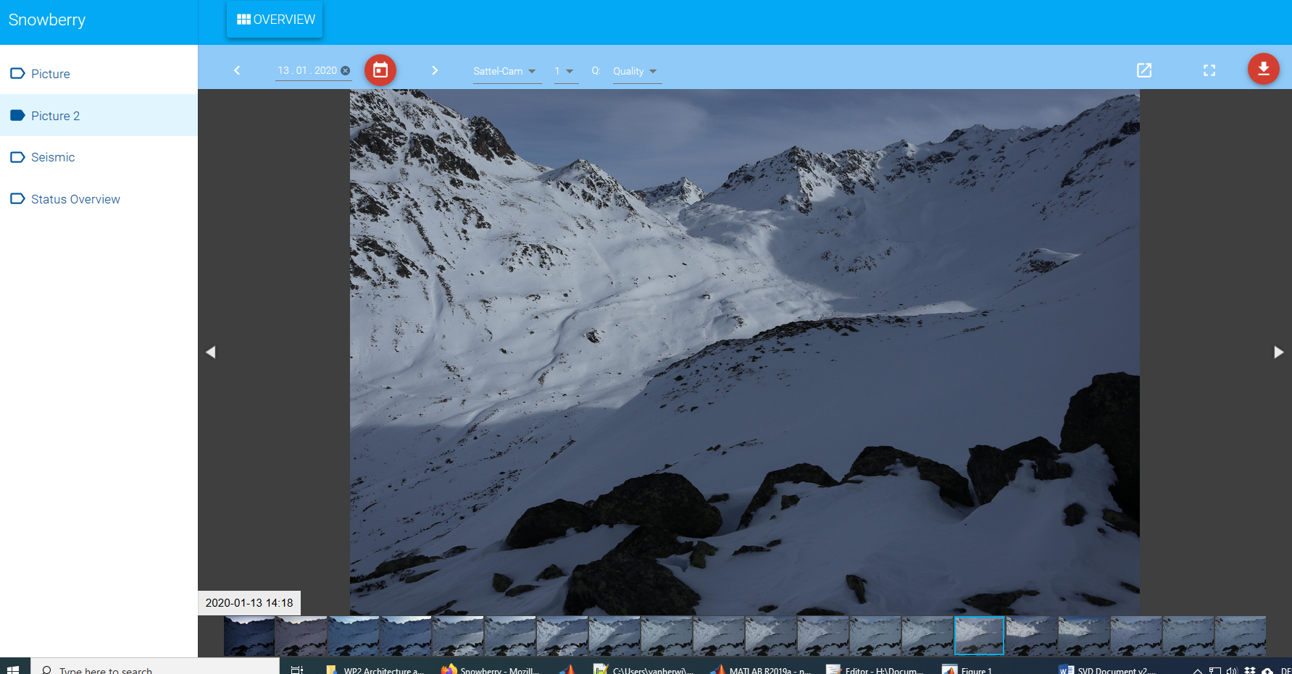
Operational camera system
Five sites with a total of 13 cameras → 6th site to be mounted soon
Images acquired every 30/60 minutes and available in near real-time

Slide 4
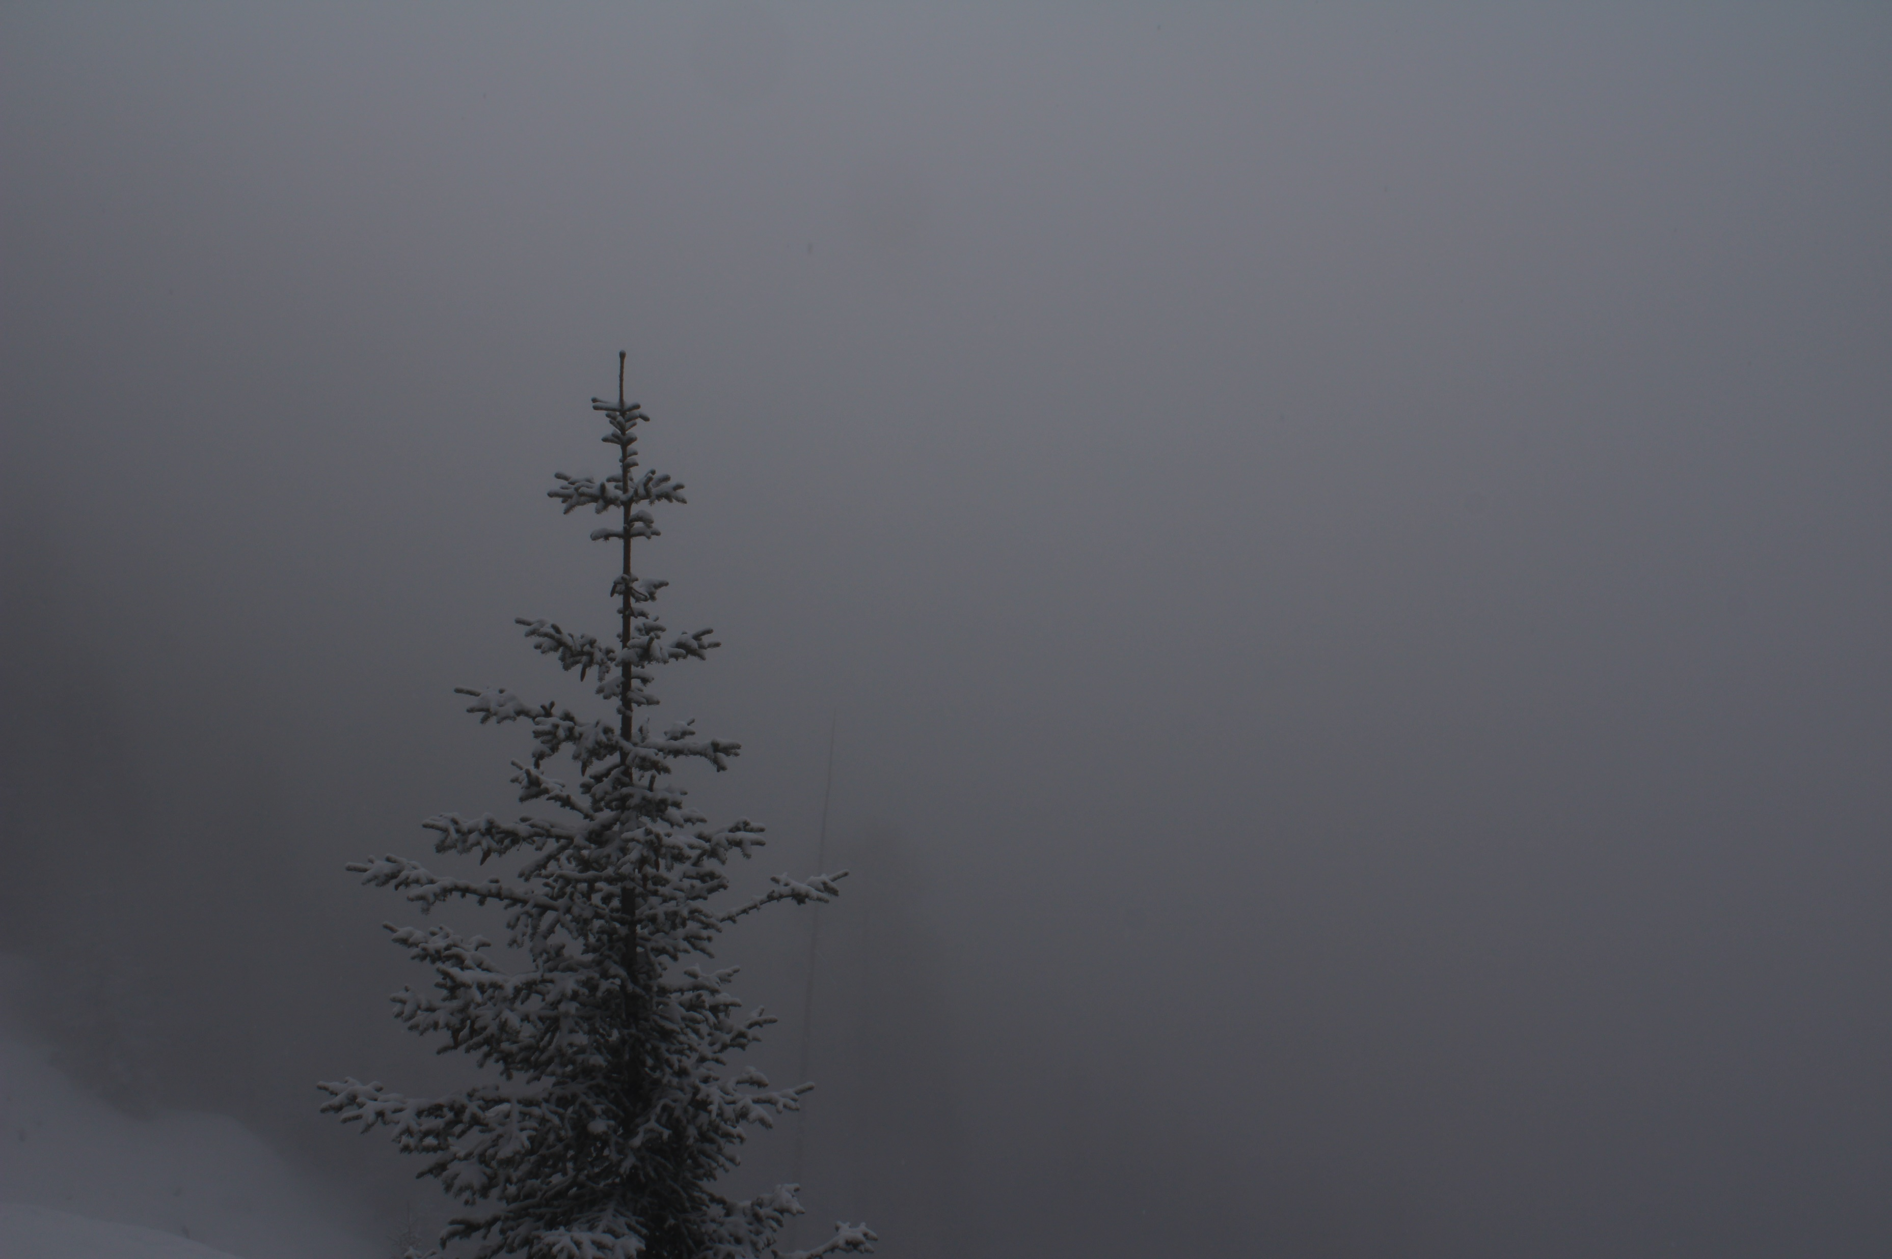
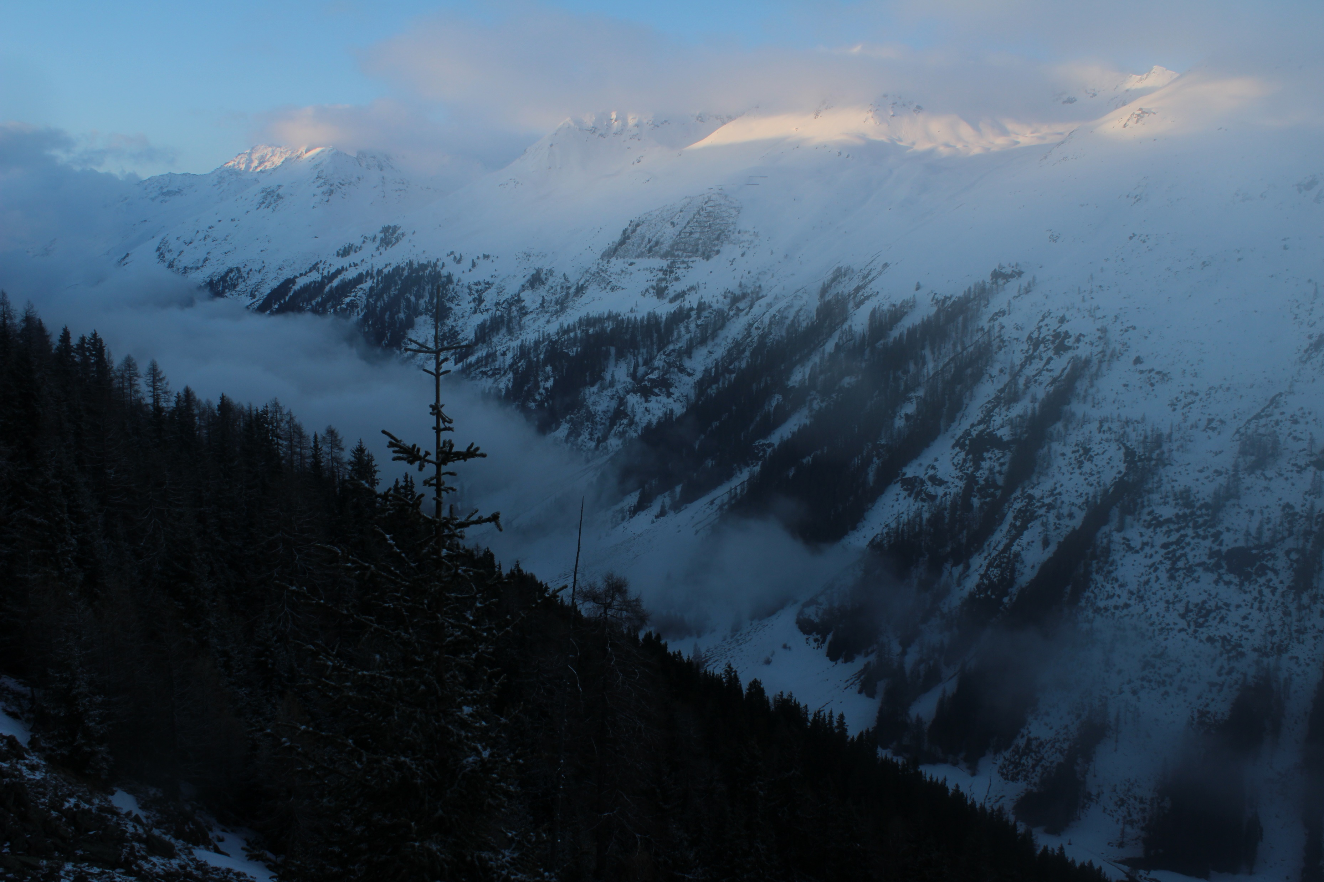
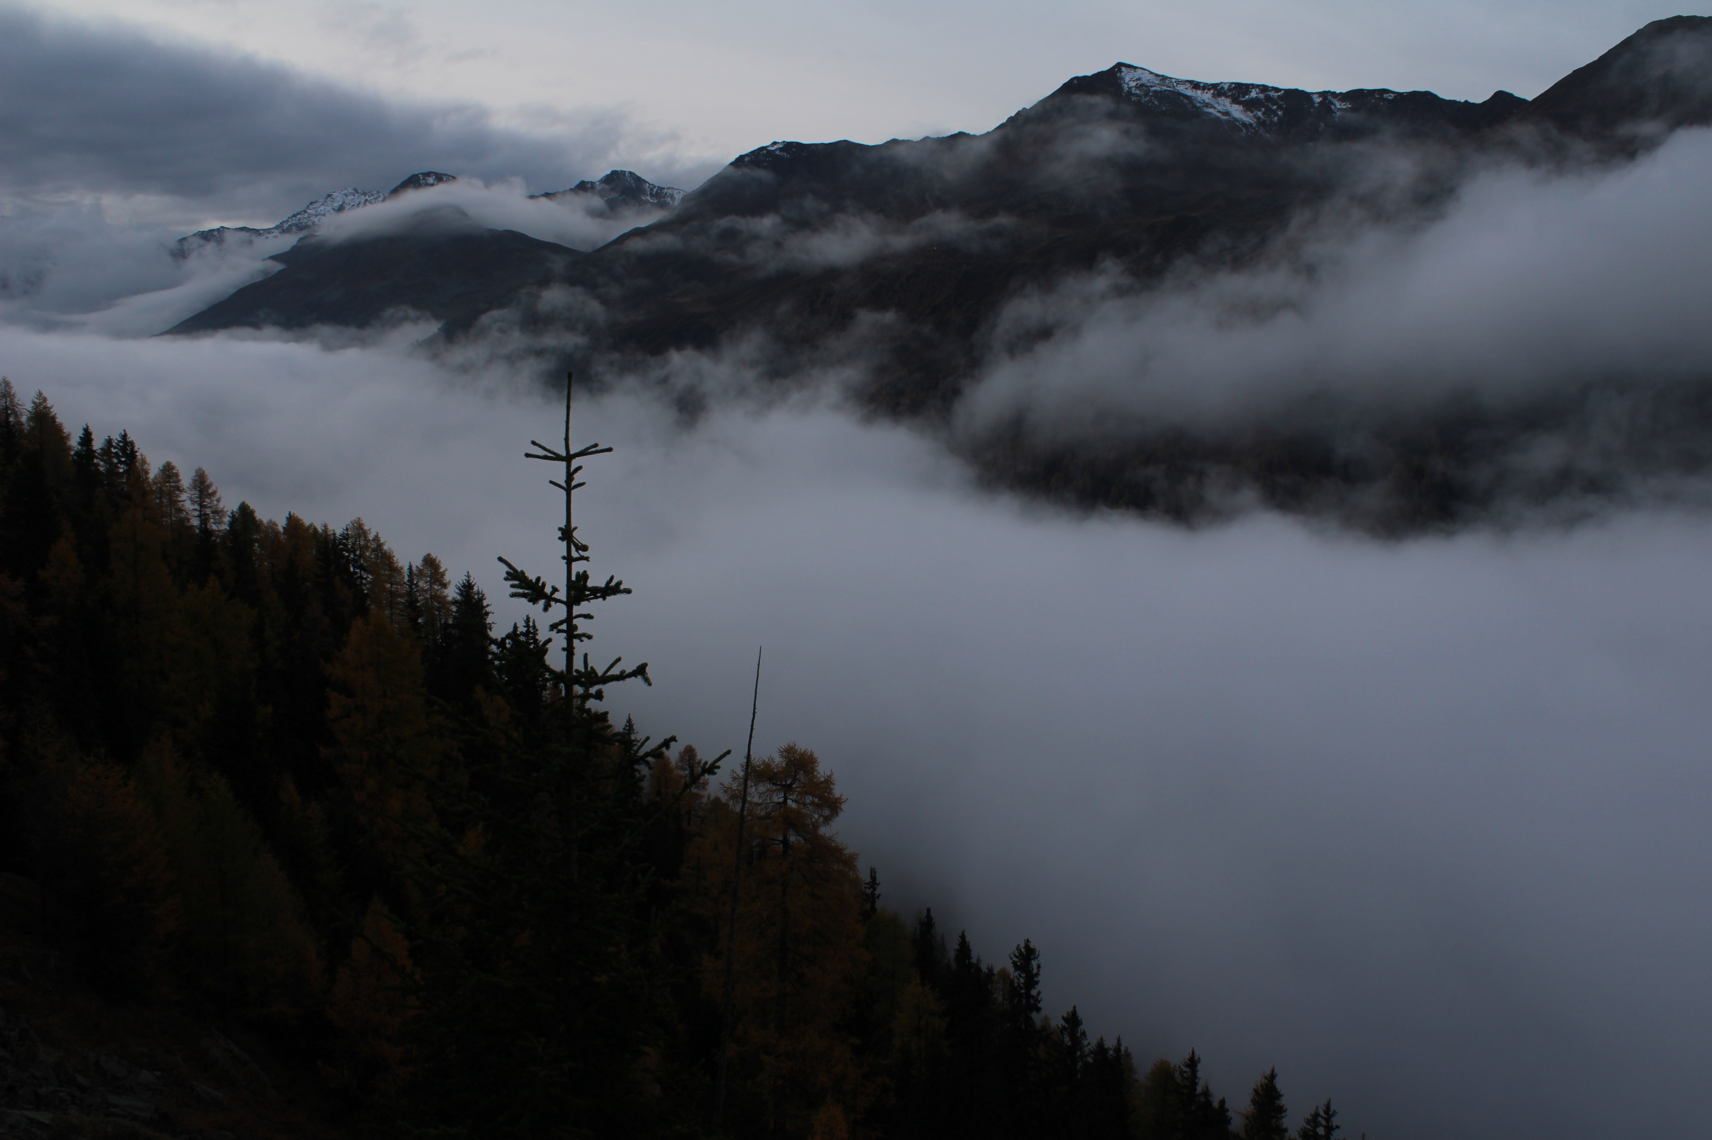
Fog/no Fog classification
currently fog index threshold distinct for each camera
calculated with manually classified images in Matlab
observed pixel intensity is used to estimate atmospheric transmittance
applied on all images per day and remaining images used for composite generation
composites used for snow classification

Slide 5
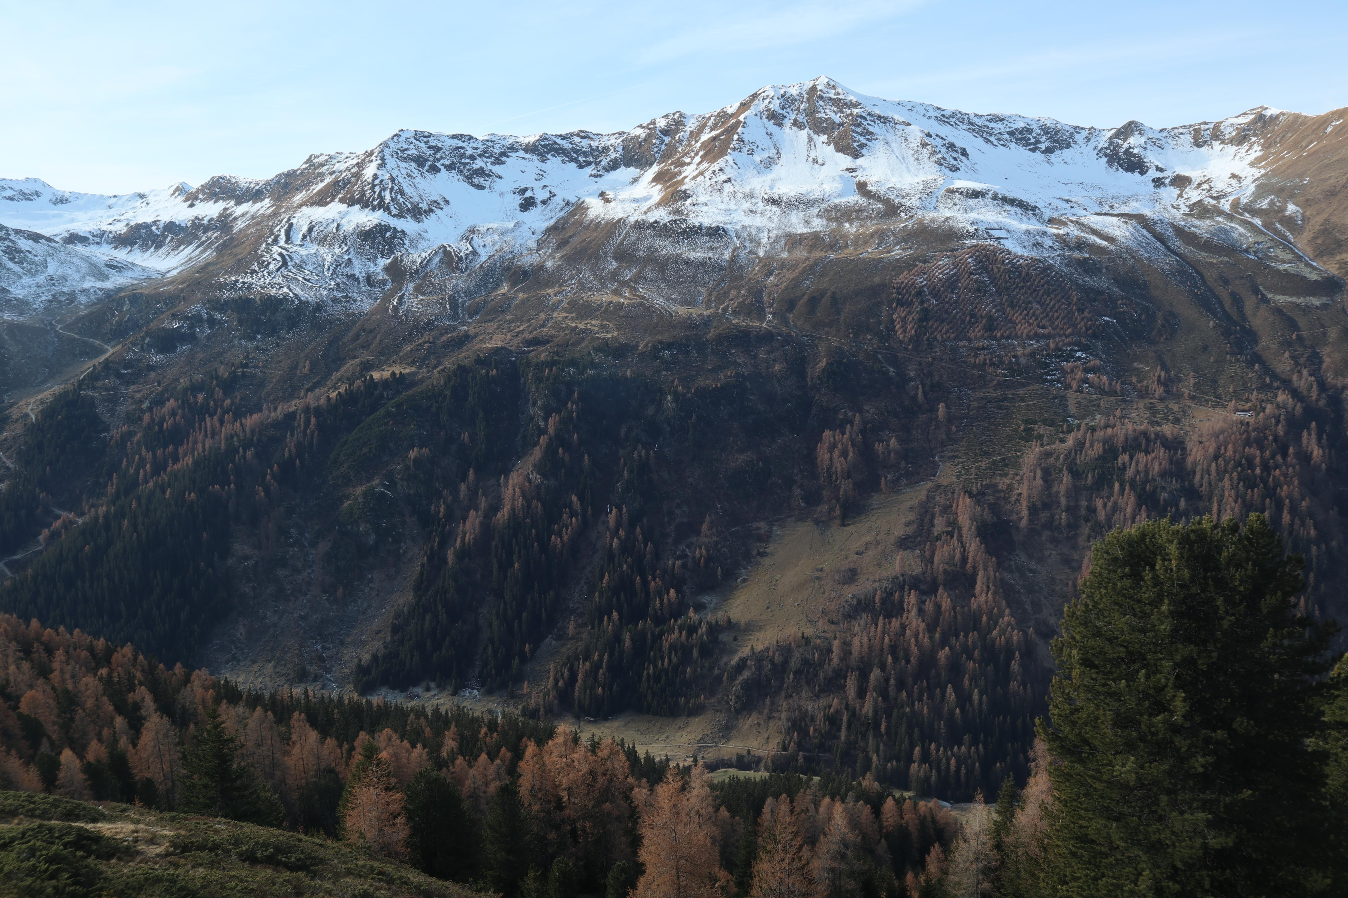
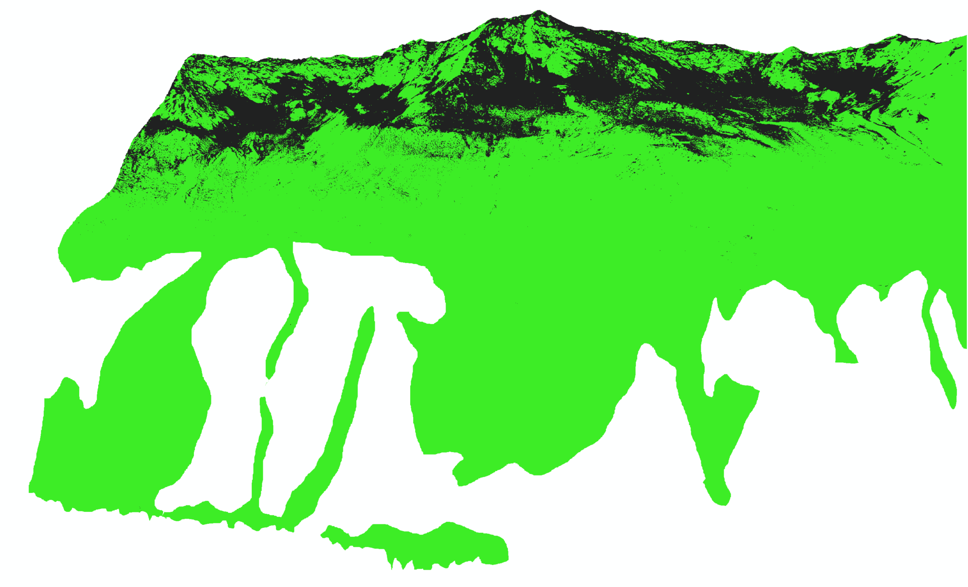
Snow Classification
Principal Component Analysis (PCA) from RGB
Thresholds: mostly snow, intermediate, sparse snow→ needs manual adaption
Results depend heavily on light and snow conditions

Slide 6
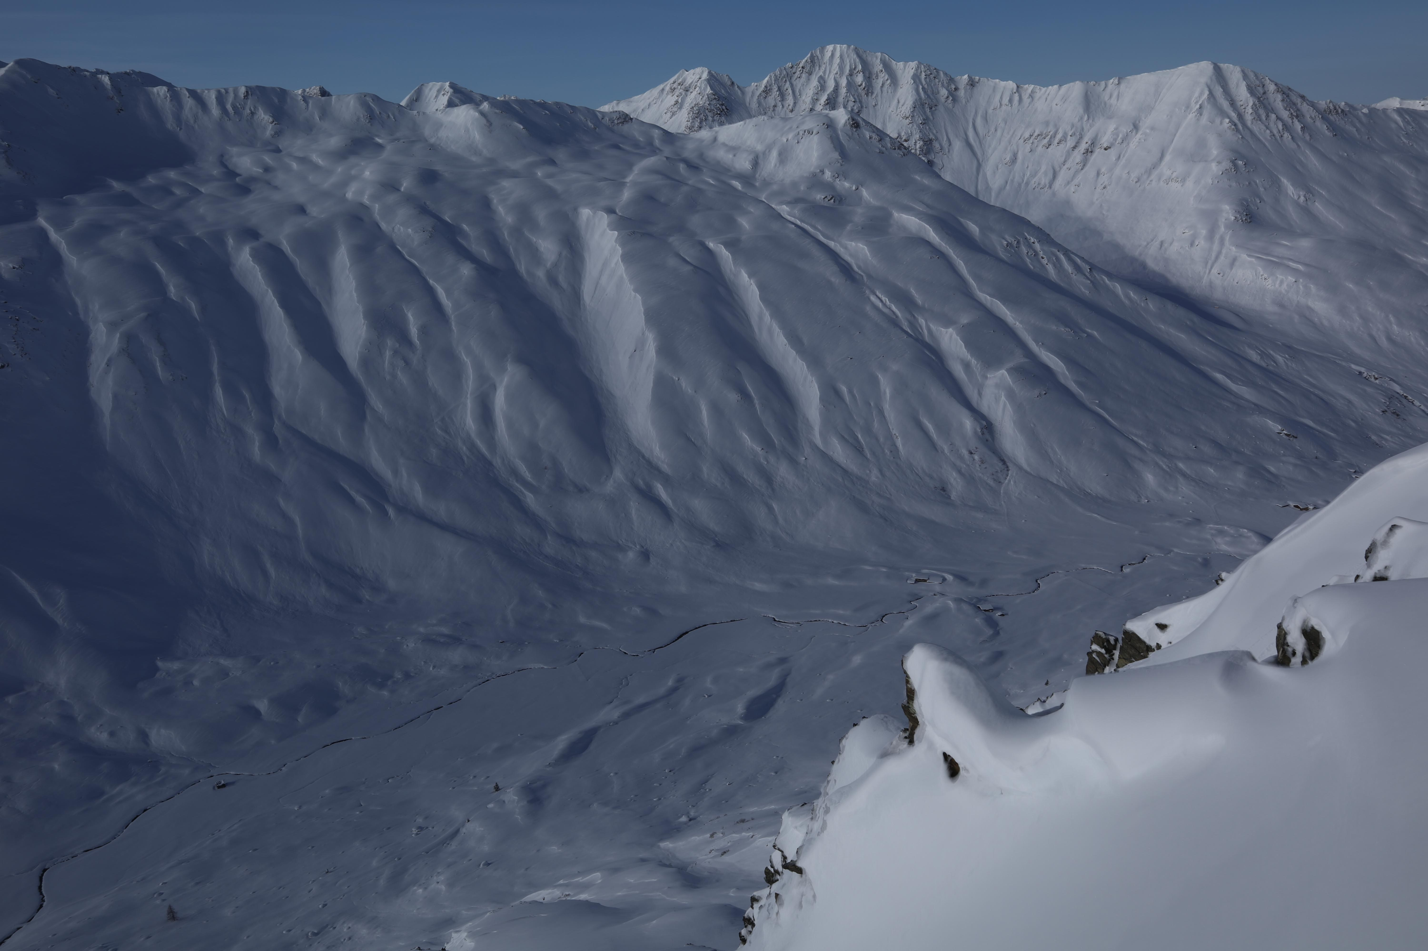
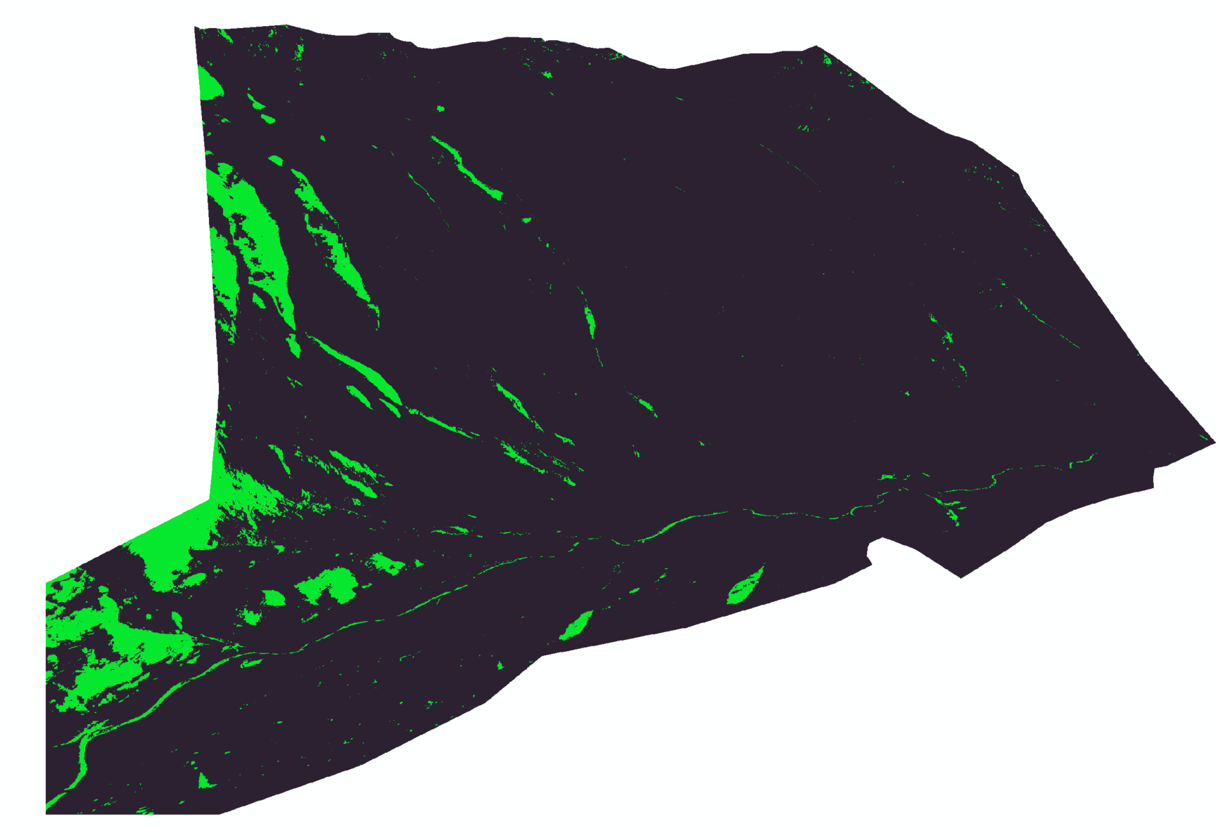
Snow Classification
Misclassification in the shade
Manual threshold adaption “always behind” and prone to misclassifications in transition from fall to winter (and winter to spring)

Slide 7
Better results through ML?
Image classification→ filtering foggy images
Semantic segmentation→ snow yes/no per pixel
train a network for snow/ no snow
different snow/ illumination conditions
1000+ images from all year round and 13 Cams available
the existing snow classifications → training
manually sort out bad images
first stations/data since summer 2019
needs to be fast→ snowmaps calculated every evening

Slide 8
Questions?

Slide 9
Next steps
let me know in until Thursday 9.12.21 if you are still interested and if yes upload your applications via Sirup
we would then be contacting you for interviews with all people supervising involved

